Slide 1

Location for new Retail Business London Borough Analysis
United KINDOM
by Magdalena Cieslak

Slide 2
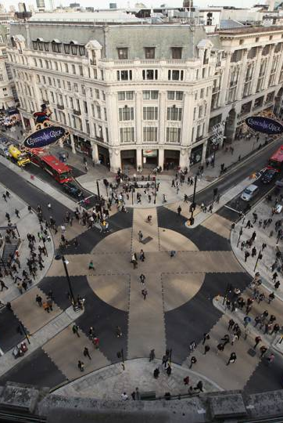
1. A description of the problem and a discussion of the background. London is one of the biggest city in Europe. Population 7.9 million on area 592.43 sq./mi. This city is attracting domestic and international investors. Analysis is for customers who planning open retails store and would like to know area better. I am planning to provide data for 32 London Boroughs about: area, population, earnings, domestic visitors spend and oversea visitor spend. I will also count correlation between them In second part I will get information about venues and categories. Then I will select venues related to retail. Finally I will form borough cluster for retail venue .
2. A description of the data and how it will be used to solve the problem.
Scraping London Borough data from Wikipedia website https://en.wikipedia.org/wiki/List_of_London_boroughs
Obtain csv. File of earnings & tourist data from government website
https://data.london.gov.uk/dataset/tourism-spend-estimates
https://data.london.gov.uk/dataset/earnings-workplace-borough
Problem: unable to find specific borough latitude and longitude file. Problem solution create own csv. File on base of Geo names organisation website https://www.geonames.org/
Collecting information about Venus using Foursquare API
Create locations and clusters map

Slide 3
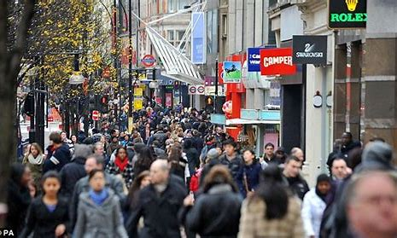
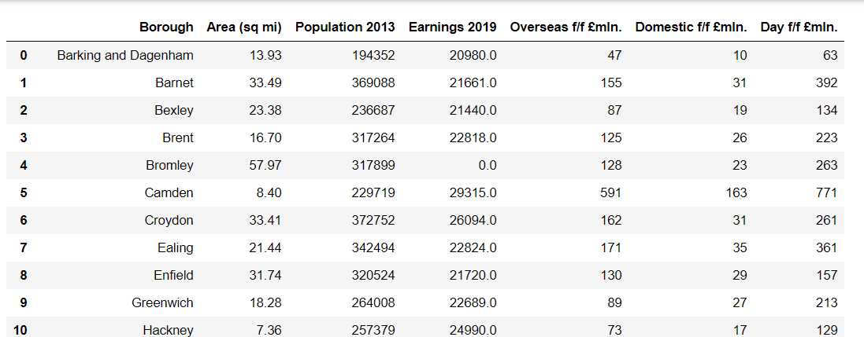
Methodology
Data Cleaning
I used Beautiful Soup library in order to scrap data from Wikipedia
Another dates were obtained from UK government page by using Panda to read the csv file.
I standardized and merged data to below format
Summary
London has 32 Borough
The biggest population : 1. Barnet , 2.Croydon, 3. Ealing
The highest income : 1. Tower Hamlets, 2. Westminster, 3. Islington
The highest Domestic spend by visitors: 1 Westminster, 2. Kingston and Chelsea, 3. Camden
The highest oversea spend by visitors: 1. Westminster, 2. Kingston and Chelsea. 3. Camden

Slide 4
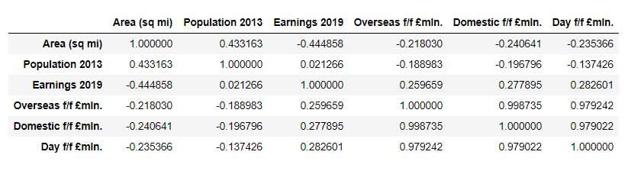
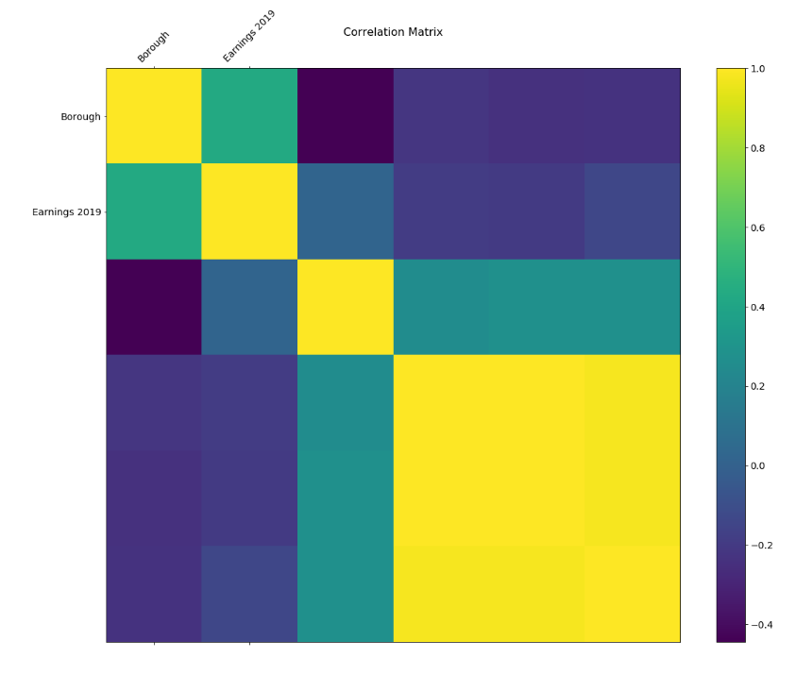
Correlation
I used matplotlib to visualised relationship between variables. I counted P-value.
Only Earning 2019 has P-value <<0.05

Slide 5
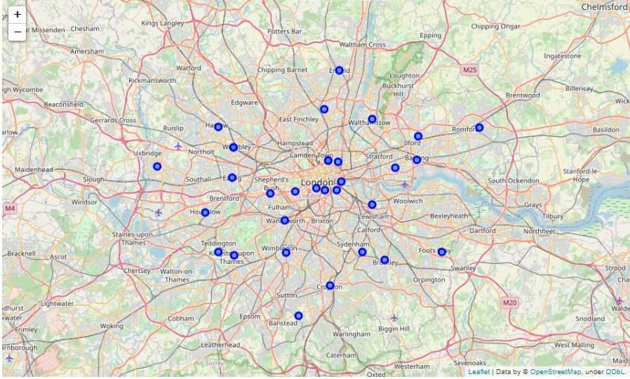
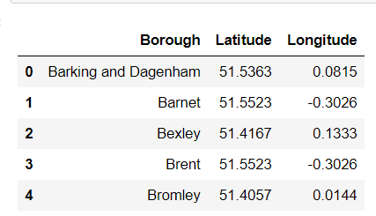
Getting coordinates & Visualise
I created specific csv file with London Borough using Geo names organisation website. I visualised 32 borough on map using folium

Slide 6
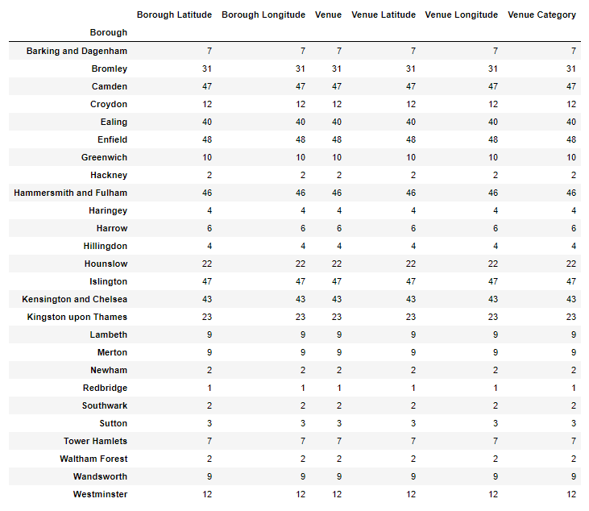
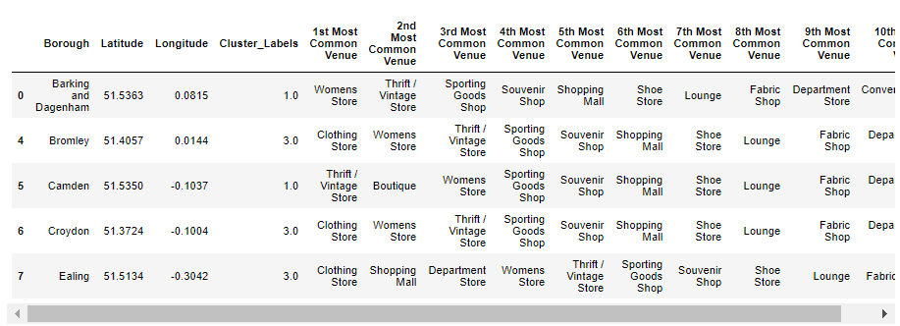
Utilizing the Foursquare API to explore the borough's and segment them
Retuned: 10 common venues for each of borough
Table showing number
of Venus category
for each borough

Slide 7
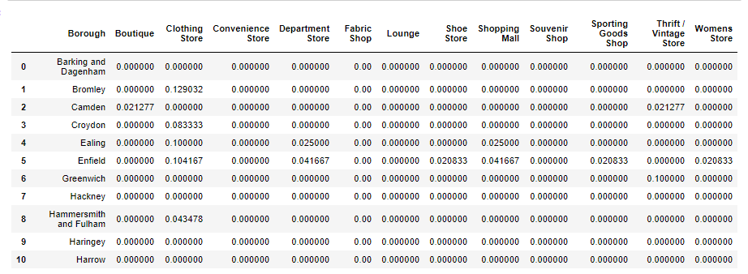
Creating new freq. Data for Retail Stores

Slide 8
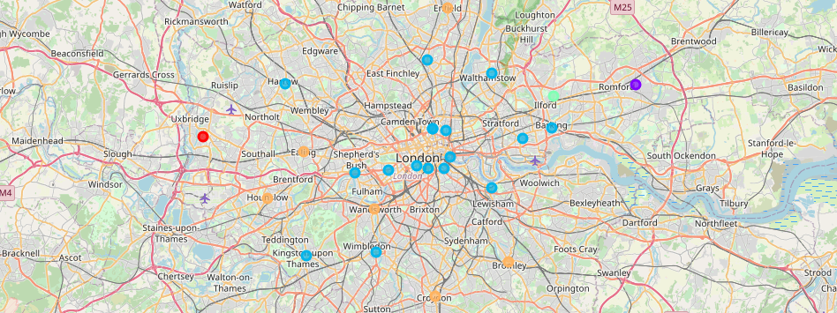
Results
I run the K-means clustering for London Retail store data. Visualisation by folium
Blue colour is related to cluster 3

Slide 9
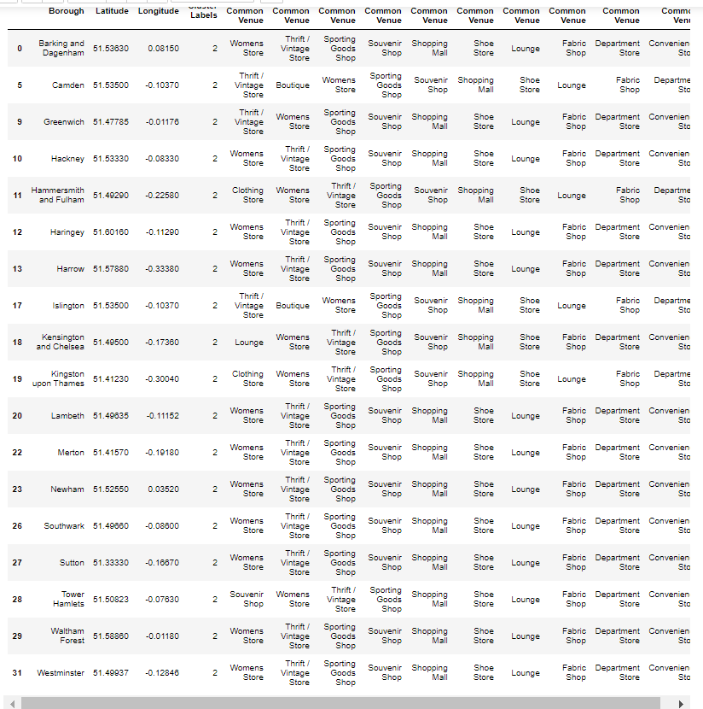
Discussion The goal was to provide information about location for new business Compering results of population, aera, earning and visitors spend we obtain 3 localization Westminster, Kingston and Chelsey, Camden. Annalise our biggest cluster3 all those localization are included. The most popular venues are Women's Store, Clothing store and Vintage store On the other hand Closter 5 may be suitable for the business as well.. The most popular venues are Clothing store, Shopping Mall, Department store

Slide 10
Conclusion
This project conclude that
3 London Borough with the highest
Income are potentially good
for new business location
Tower Hamlet
Westminster
Islington

